Slide 1
ECPS 204 Discussion
Deep Learning on Raspberry Pi
Assignment 5

Slide 2
Assignment 5
Raspberry pi is capable of performing deep learning and object detection.
In this assignment there are two parts-
Part 1– Deep Learning with OpenCV and Image Classification using OpenCV and various pre-trained Caffe models
Part 2- Real-Time Object Detection using OpenCV and the pre-trained Caffe model

Slide 3
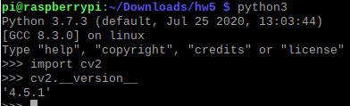
Step 1- Installing OpenCV for Python 3
Install the following dependencies:
$ sudo apt-get install libatlas-base-dev
pip3 install imutils
Install OpenCV 3.3:
$ sudo pip3 install opencv-python
Check if it works with:
$ python3
>>> import cv2
>>> cv2.__version__
And ctrl + D to leave Python3

Slide 4
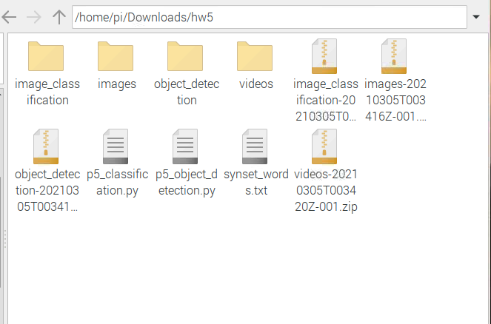
Step 2- Downloading the source files
Download the source files from the google drive folder and extract them in your Raspberry pi.
Two additional files will be required- p5_classification.py and synset_words.txt for a total of six files.

Slide 5
Step 3- Running the Image Classification
To run the GoogleNet Image classifier use the following command-
$ python3 p5_classification.py -i /path/to/image/eagle.png -p /path/to/prototext/bvlc_googlenet.prototxt.txt -m /path/to/cafemodel/bvlc_googlenet.caffemodel -l /path/to/synset_words.txt
Paths should be set correctly to avoid errors. Next slide shows an example.

Slide 6
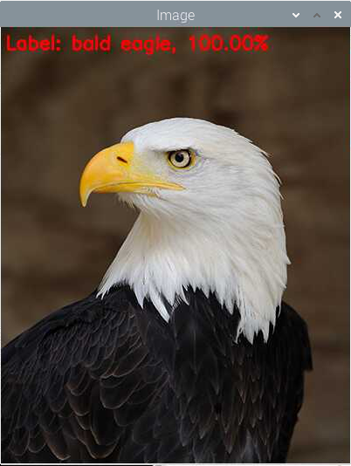
Image Classification of eagle.png
I have stored my files in the /home/pi/Downloads/hw5 folder. The command I use is-
$ python3 p5_classification.py -i /home/pi/Downloads/hw5/images/eagle.png -p /home/pi/Downloads/hw5/image_classification/googlenet/bvlc_googlenet.prototxt.txt -m /home/pi/Downloads/hw5/image_classification/googlenet/bvlc_googlenet.caffemodel -l /home/pi/Downloads/hw5/synset_words.txt
Try to use the other image classification models and observe their accuracy and other relevant parameters.

Slide 7
Assignment questions-
For the assignment answer the questions in step 2-part 4 on the webpage.
After testing the six image classification models, create a table with the following parameters-
Time to execute the program
Computational Complexity in Gflops
Model size in MB

Slide 8
Part-2 Object Detection using OpenCV
Object detection can classify individual objects in the image and can also identify the positions of the objects.
We will be using the SSD(Single Shot Detector).
The file that is required is the p5_object_detection.py and the previously downloaded files.

Slide 9
Running the Object Detector
Use the command -
$ python3 p5_object_detection.py -i /path/to/video/ground_crew_480p.mp4 -p /path/to/ssd/files/MobileNetSSD_deploy.prototxt.txt -m /path/to/ssd/files/MobileNetSSD_deploy.caffemodel --confidence 0.2

Slide 10
Example of Object Detector
My files are stored in /home/pi/Downloads/hw5 the command for me is-
python3 p5_object_detection.py -i /home/pi/Downloads/hw5/videos/ground_crew_480p.mp4 -p /home/pi/Downloads/hw5/object_detection/MobileNetSSD/MobileNetSSD_deploy.prototxt.txt -m /home/pi/Downloads/hw5/object_detection/MobileNetSSD/MobileNetSSD_deploy.caffemodel --confidence 0.2

Slide 11
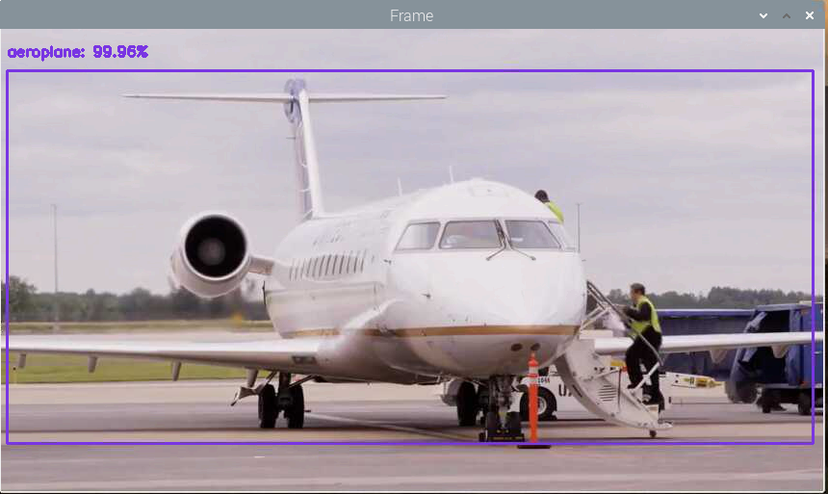
Example Output

Slide 12
Assignment questions-
Answer the questions in step 3- part 4 in your report.
For the demo session show both image classification as well as object detection. Try to use other images/video other than the examples provided.
For this project you can work in groups of 2.

